Slide 1






Multi-armed bandit problem
10LF211:
Andreea Andrei
Biserică Maria

Slide 2


What are online algorithms?
Online algorithms represent a theoretical substructure for studying problems in interactive computing.
They model, in particular, that the input in an interactive system doesn’t arrive as a batch but as a sequence of input portions and that the system must react in response to every incoming portion.
Furthermore, they take into account the fact that future input is unpredictable at any given time.

Slide 3

Let’s talk about Reinforcement Learning
This is an Artificial Intelligence technique in which an agent has to interact with an environment, selecting one of the offered actions the environment provides in each potential state and collecting a non-deterministic reward depending on the action taken.

Slide 4

Project description

Slide 5

The multi-armed bandit model is a simplified version of reinforcement learning that exemplifies the exploration–exploitation tradeoff dilemma. A good example is a gambler who faces multiple slot machines. Each slot machine is configured differently, with an unknown probability of getting a reward within the first use.
Bandit?

Slide 6
What is the most effective strategy to attain highest long-term rewards?
THE QUESTION

Slide 7
The dilemma comes from the incomplete information. We need to collect enough information to make best overall decisions while keeping the risk in check.
With exploitation, we take advantage of the best option we know.
With exploration, we take some risk to gather information about unknown options.
The best long-term strategy may involve short-term sacrifices. As an example, one exploration trial may be a complete failure, but it warns us of not taking that action too often within the future.

Slide 8


How Solving the Multi-Armed Bandit Problem Can Move Machine Learning Forward

Slide 9
The exploration vs exploitation dilemma exists in many aspects of our life, therefore there are many practical applications of the bandit model, for example:
Recommendation Services ex: Netflix has to decide which movies to place most prominently in your ‘Browse’ page
Managing Research Projects in a large organization like a science foundation or a pharmaceutical company
Clinical Trials investigating the consequences of different experimental treatments while minimizing patient losses
A/B Testing to enhance the design of websites
Dynamic Pricing automatically optimising the price of products
Adaptive Routing Efforts for minimizing delays in a network

Slide 10

innovation
Applications sometimes call for an algorithm which learns quickly, but sacrifices optimal long term performance. The inherent tradeoffs with learning algorithms lead to varying performance in the short term, within 200 iterations and long term, at 1000 iterations.
The choice of the multi-arm bandit problem is motivated by its application to machine learning as a way to effectively measure the performance of learning algorithms. Our paper strengthens the results of the previous papers. It aims to present the optimal choice of the learning algorithm based on a Gaussian or Bernoulli distribution, with a practical and easy-to-understand implementation of the algorithm.

Slide 11
existing applications
Gradient bandit with softmax action preference
Epsilon-greedy
1
4
2
3
Boltzmann
Upper confidence bound

Slide 12
There are various solutions that computer scientists have developed to tackle the multi-armed bandit problem. Below is a list of some of the most used multi-armed bandit solutions:
Epsilon-greedy
This is an algorithm for continuously balancing exploration with exploitation. In ‘greedy’ experiments, the lever with highest known payout is always pulled except once a random action is taken.
Gradient Bandit with softmax
Considers learning a numerical preference Ht(a) for each action a. The larger the preference, the more often that action is taken, but the preference has no interpretation in terms of reward. Only the relative preference of one action over another is important.
1
4
2
3
Boltzmann exploration
The initial action distribution is partitioned by the temperature parameter in the Boltzmann policy implementation. As a result, the Boltzmann policy transforms the agent's exploratory behavior into a spectrum ranging from taking the action at random (random policy) to always picking the most optimum action (greedy policy).
Upper confidence bound
This strategy is based on the Optimism within the Face of Uncertainty principle, and assumes that the unknown mean payoffs of every arm are going to be as high as possible.

Slide 13
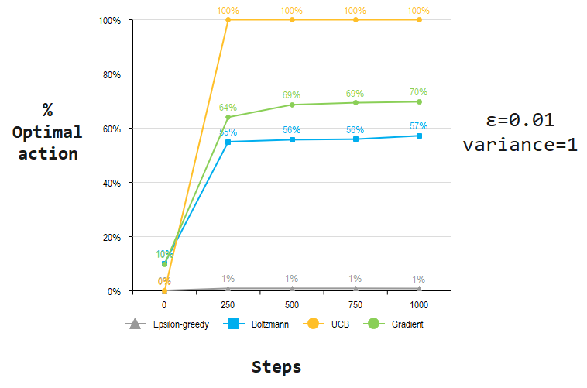
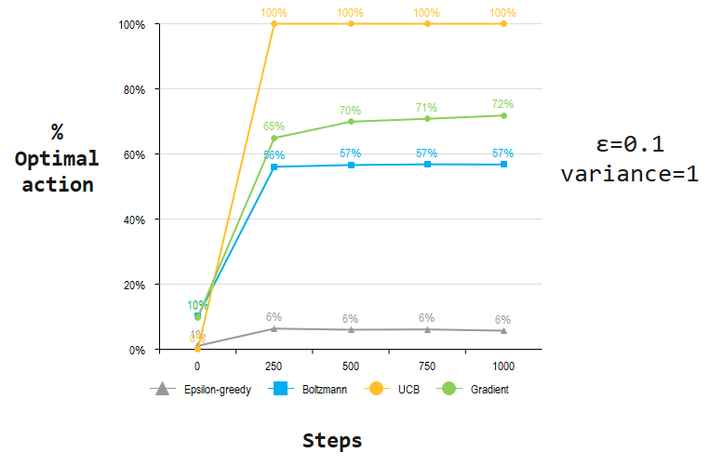
GAUSSIAN DISTRIBUTION – 10 – ARMED TESTBED

Slide 14
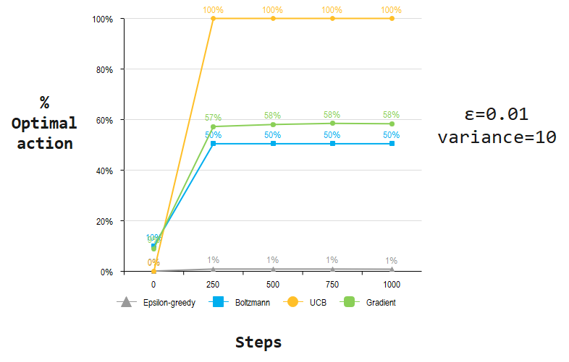
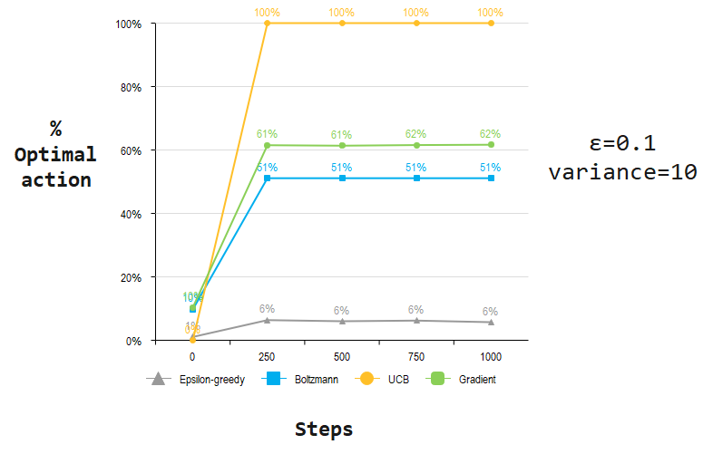
GAUSSIAN DISTRIBUTION – 10 – ARMED TESTBED

Slide 15
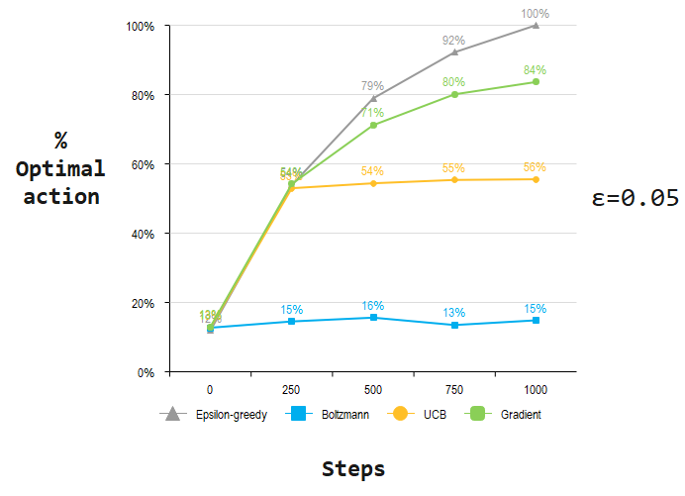
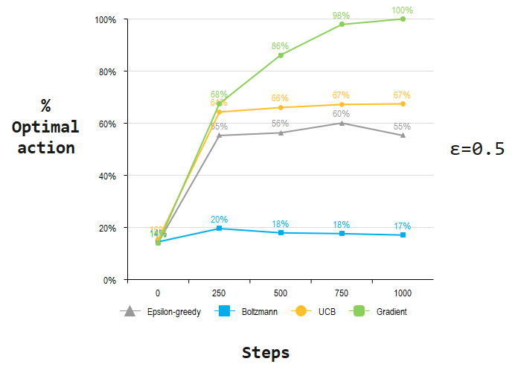
BERNOULLI DISTRIBUTION – 10 – ARMED TESTBED

Slide 16
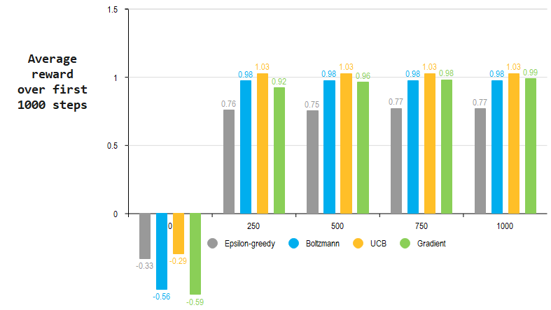
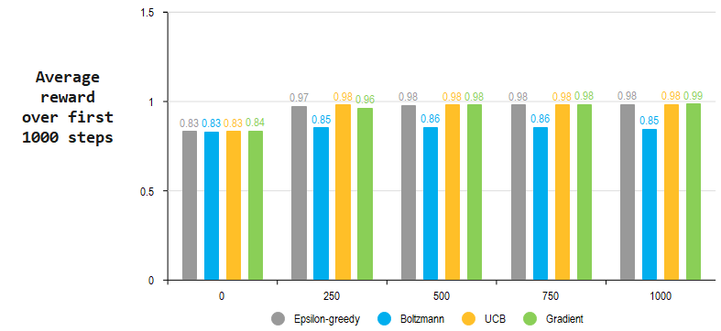
AVERAGE REWARDS – 1. GAUSSIAN , 2.BERNOULLI

Slide 17
DISCUSSIONS
Which of these strategies is the most effective?
Despite the fact that this is a tough issue to answer in general, we can run them all on the 10-armed testbed and compare their results. The fact that they all have a parameter complicates things; in order to provide a meaningful comparison, we will have to consider their performance as a function of their parameter.
So far, our graphs have illustrated the progression of learning over time for each algorithm and parameter setting, but showing such a learning curve for each algorithm and parameter value would be too visually confusing. Instead, we summarize a complete learning curve by the average results of optimal action choice and rewards collected over the first 1000 steps.

Slide 18
DISCUSSIONS
Percentage of optimal action selection
As shown in the graphs above, in the case of Gaussian distribution, the modification of probability ε and variance in the selection of the action values determines the variation in the optimal choice of an action, but the ranking of the methods according to performance remains unchanged, the Upper-Confidence-Bound action selection strategy being the most efficient. Thus, on the 10-armed testbed, it seems pretty clear which method has the best chance of choosing an optimal action.
In terms of Bernoulli distribution, from testing, we notice that an algorithm that is optimal in the first 250 turns can be outperformed by another algorithm in the long term. When epsilon has a lower value (ε=0.05), the ε-greedy exploration strategy tends to perform best of all methods but is followed closely by Gradient Bandit with SoftMax action preference and UCB in the first 250 step. When epsilon is bigger (ε=0.5) the Gradient Bandit behaves optimally, ε-greedy falling in third place. So in order to choose the optimal method, one must consider whether optimal results are desired in the long or short term for the problem in cause.

Slide 19
DISCUSSIONS
Average reward over first 1000 steps
If we draw a parallel between the two distributions, the discrepancy between the reward collected initially stands out. For the Gaussian model, all methods start at negative mean rewards, but there is a jump to positive values that for some strategies, such as UCB, even exceed the rewards collected in the Bernoulli simulation.
For the aforementioned distribution, we follow a constant and controlled path of collecting rewards. Each action has an expected mean reward that starts from good values but does not signal a significant increase, not overtaking the verge of 1.
It both cases, it is noticeable a strategy whose rewards are lower, compared to the rest of the exploration methods that exhibit fairly close values. These are epsilon-greedy for the Gaussian simulation and Boltzmann for the Bernoulli simulation.

Slide 20
CONCLUSIONS
While an analysis of many distributions would be needed to draw broader conclusions, the two distribution types we implemented had little impact on performance. It may be that Gaussian and Bernoulli distributions give similar results as the repeated sampling of a Bernoulli distribution is a binomial distribution, which is essentially a discrete Gaussian. Different results may be obtained using other distributions, such as the exponential.
In comparison to the Gaussian distribution simulation model, the exploration strategies in the Bernoulli distribution simulator run substantially quicker in the 10-armed testbed. This is an indicator for determining which distribution is more efficient in terms of execution time.

Slide 21
CONCLUSIONS
As can be seen, the standard deviation for the algorithms under the Gaussian distribution is much larger than that of the Bernoulli. The Gaussian's continuous nature is a potential cause for this difference. This leads to a higher chance that small sample size will result in an average that is much less than expected. If this happens to the best arm, it is likely to converge to a different arm in epsilon-greedy, especially if epsilon is decaying quickly.
When it comes to Gradient Bandit with SoftMax action preference, there is a much smaller chance that the best arm is chosen, so in order to correct the initial bias, there will be needed a lot more trials. For epsilon greedy, this can be solved through a slower decay, at the cost of longer convergence times. In the case of Softmax, attempting to reduce this likelihood will result in worse convergence due to the arms having more equal probability.
Although the strategies explored may be the best we can do at present, they are far from a fully satisfactory solution to the problem of balancing exploration and exploitation.
But despite their simplicity, the approaches provided in this paper are, in our opinion, deemed the state of the art. There are more sophisticated methods, but their complexity and assumptions make them impractical for the reinforcement learning problem.

Slide 22

References
Reinforcement Learning: An Introduction (Sutton, R., S., Barto, A., G., 2014, 2015)
SuttonBartoIPRLBook2ndEd.pdf (stanford.edu)
The Multi-Armed Bandit Problem and Its Solutions (lilianweng.github.io)
Solving the Multi-Armed Bandit Problem | by Anson Wong | Towards Data Science
How to Build a Product Recommender Using Multi-Armed Bandit Algorithms - OfferZen
Reinforcement Learning: Multi-Armed Bandit | Medium
part1-MultiarmedBandit.ipynb - Colaboratory (google.com)
Your Client Engagement Program Isn't Doing What You Think It Is. | Stitch Fix Technology – Multithreaded
Bandit Algorithms (tor-lattimore.com)
Reinforcement Learning Introduction | Mosaic Data Science Blog
How Solving the Multi-Armed Bandit Problem Can Move Machine Learning Forward – The New Stack
Multi-Armed Bandits: Exploration versus Exploitation (stanford.edu)
MAB-Survey.pdf (umich.edu)
Multi_Arm_Bandit_final_report.pdf (arizona.edu)
Multi-armed bandit and Thompson Sampling in C++ and Python | gcardone’s blog
GitHub - nicoleorzan/Multi-armed-bandit-RL: C++ implementation of Multi-Armed Bandits (Gaussian and Bernoulli)
Using Boltzmann distribution as the exploration policy in TensorFlow-agent reinforcement learning models | Bartosz Mikulski (mikulskibartosz.name)

Slide 23


timeline
Research and Implementation: Testing already existing algorithms/Prototype selection (25.11 – 09.12)
Coding / Practical Application : Looking for ways to optimize the algorithm (10.12 -24.12)
Finishing touches: Final check of code efficiency, Formatting collected data/Preparing the presentation (27.12 – 06.01.2022)

Slide 24


Team Presentation
Andreea Andrei
MARIA Biserică

